Slide 2
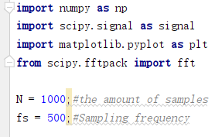

Slide 3
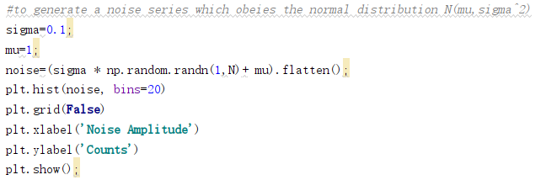
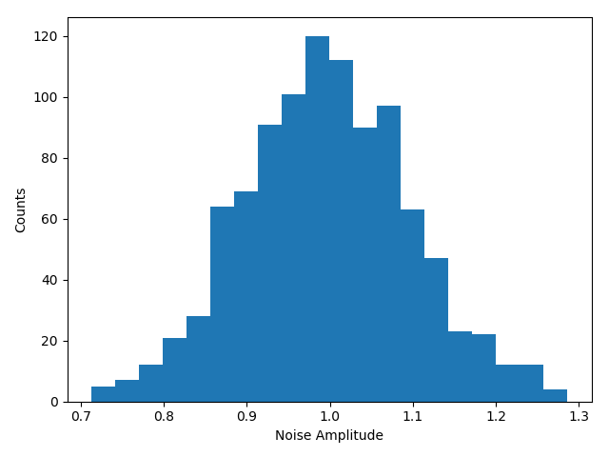

Slide 4
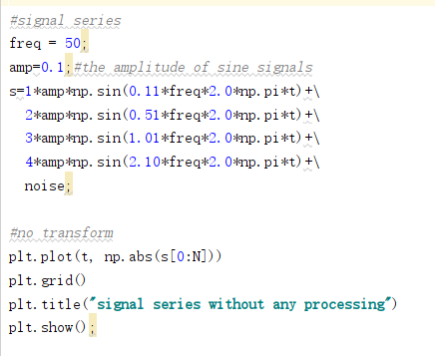
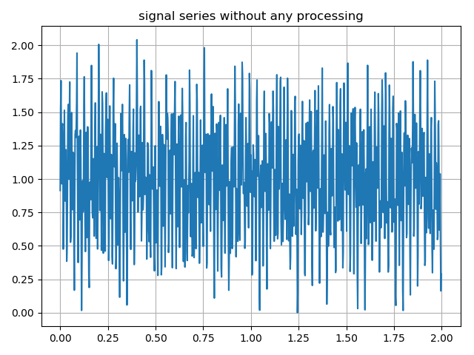

Slide 5
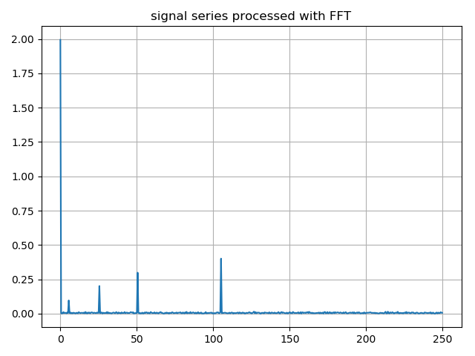
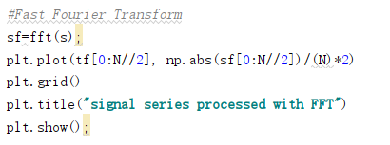

Slide 6
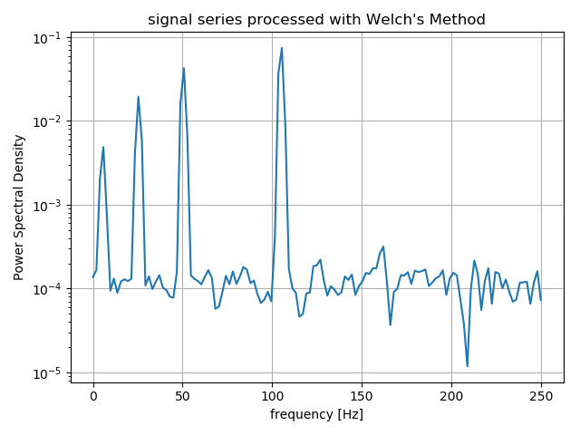
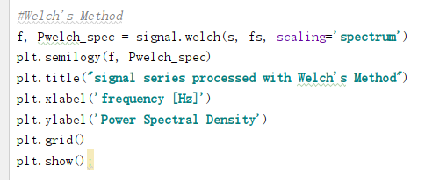

Slide 7
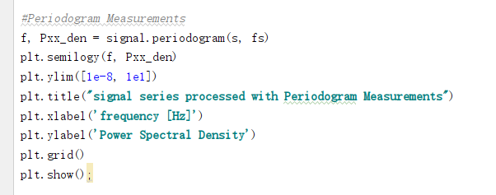
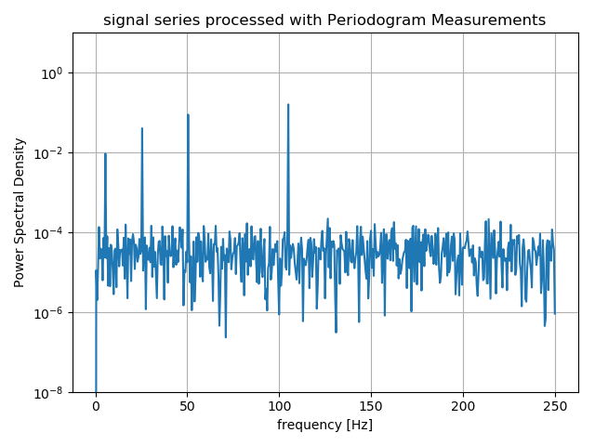

Slide 9
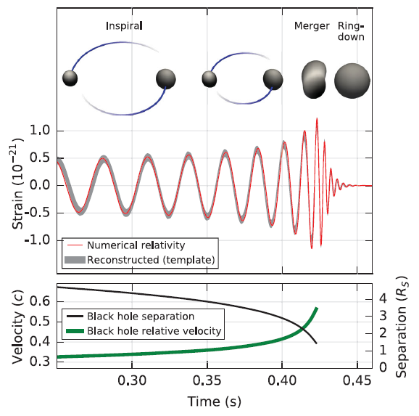
What shape of signals do we expect?
Peak(Particle) or Wave?
Transient or Constant?
PhysRevLett.116.061102-Observation of Gravitational Waves from a Binary Black Hole Merger

Slide 10
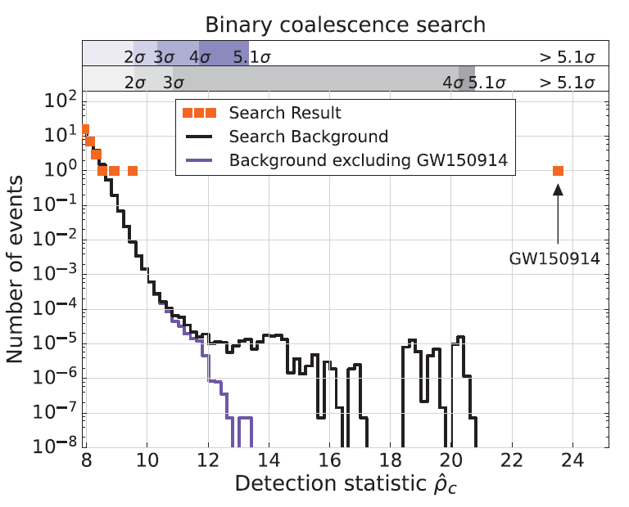
Whatever the shape of signals is, Could signals be buried beneath the background?
PhysRevLett.116.061102-Observation of Gravitational Waves from a Binary Black Hole Merger

Slide 11
An assumption
How to understand ‘normal’ or ‘abnormal’
Normally,
When there’s no actual signal,
Signal series(arranged by time) from two sensors are irrelevant random noise.
Why mention time order here
Random means they are not alike

Slide 12
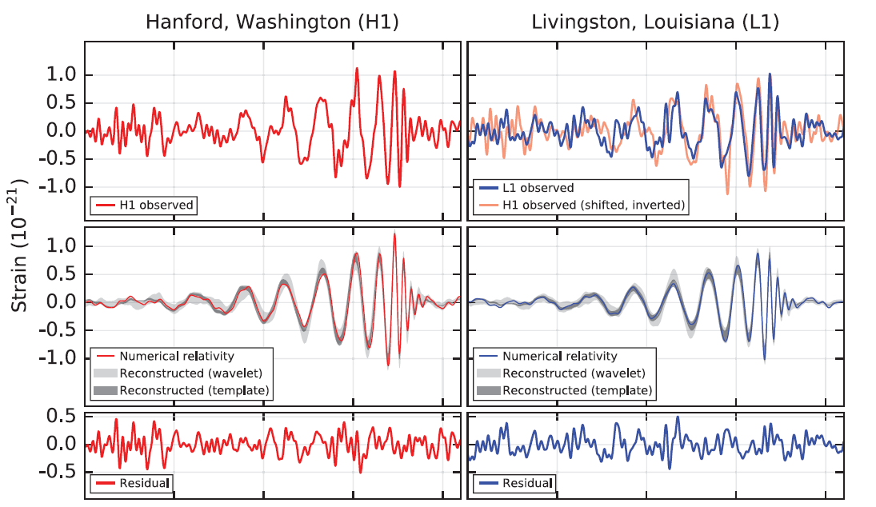
PhysRevLett.116.061102-Observation of Gravitational Waves from a Binary Black Hole Merger

